Slide 1
World Development Measurement
By group-2

Slide 2
Objective:
Creating clusters on the global development measurement dataset
The dataset has information about important economic and development metrics related to various countries across the globe.

Slide 3
Project Flow:
Dataset Understanding
EDA process
Feature Engineering
Model Building
Deployment

Slide 4
Data Set Details:
The data file contains 2708 observations with 25 variables and has information about important economic and development metrics related to various countries across the globe.
The variables, or features, are the following:
Birth Rate, Business tax, CO2emissions, Country, Days to start a business, Ease of business, energy usage, GDP, healthexp%GDP, healthexp/capita, hours to do tax, infant mortality, internet usage, lending rate, life expectancy female, etc.

Slide 5
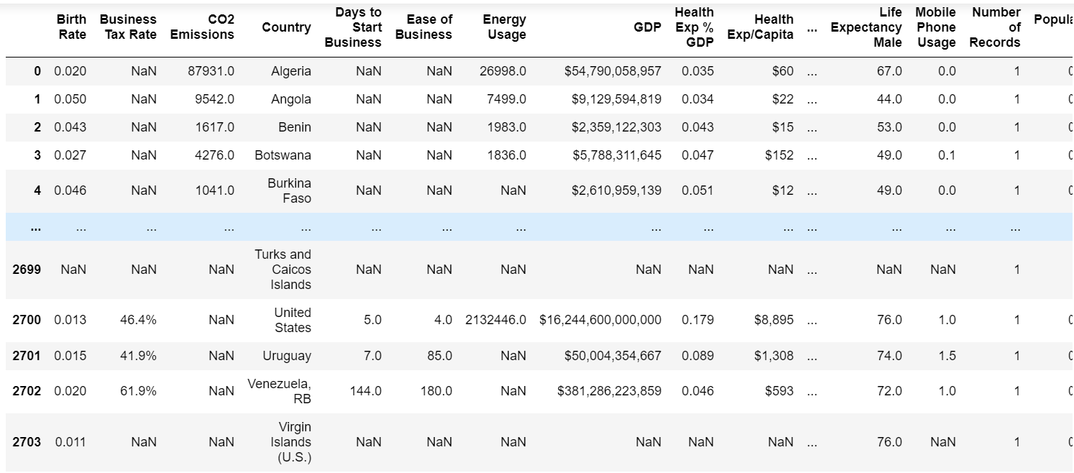
Data Set:

Slide 6
EDA:
In the given dataset the datatype of the observations in each variable are floating point datatypes.
In the data set each feature contains null values.
There are no duplicate observations present in the dataset.
There are a total of 12203 null values present in the dataset.

Slide 7
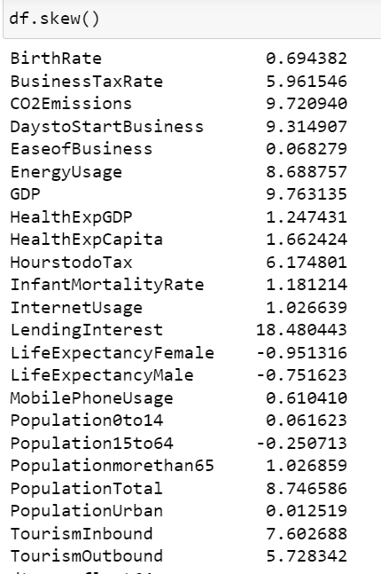
Data Distribution:
skewness

Slide 8
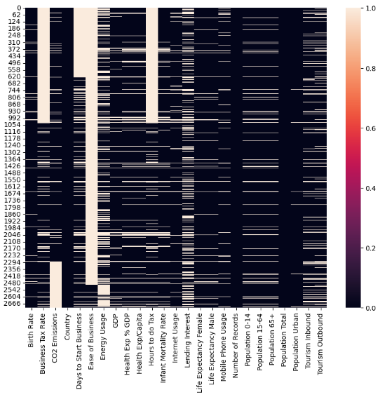
Visualizing the null values for each attribute with SNS Heatmap.
Ease of business contains more number of missing values
Population urban having less number of missing values.
There are no missing values in country and population total.

Slide 9
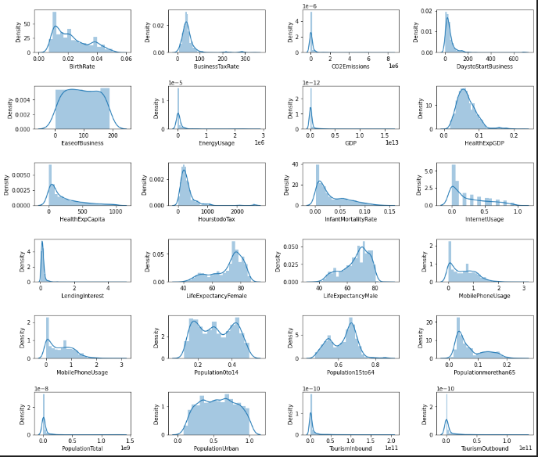
VISUALIZATION:
Distribution plots for each column
'BusinessTaxRate’, 'EaseofBusiness', 'HealthExpGDP’, 'HourstodoTax' and 'Population0to14' columns have normal distribution so we replace missing values by mean.
And for remaining columns with skewed data we replace missing values by median.

Slide 10
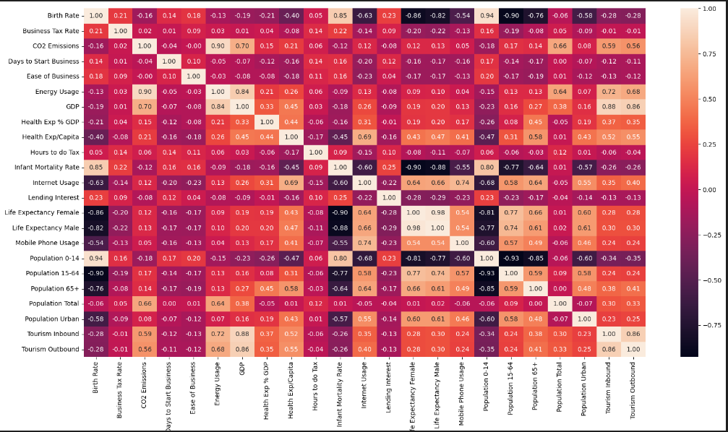
Visualizing Relation between variables:
'Population 0 to 14' and 'Birth Rate’ have a strong relation. (0.94)
‘ Population 15 to 64’ and ‘Birth Rate’ have a weak relation. (0.90)

Slide 11
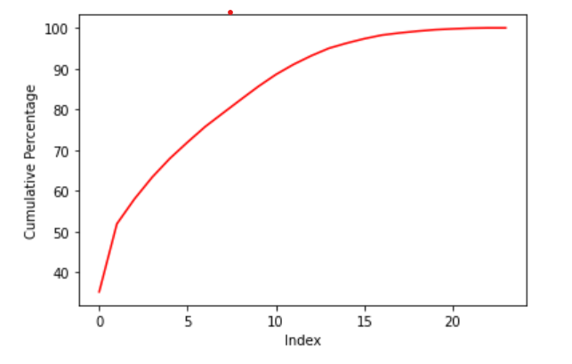
SCALING:
Scaling is a technique to standardize the independent features present in the data in a fixed range. We do this to make sure all the features are in same scale
Here we will be using Standard Scaler
Feature Engineering
PCA Technique :
Looking at the graph we can decide how much percentage we want and accordingly go for that much column numbers.
here, we are taking 15 columns because they are giving more than 95% data.

Slide 12
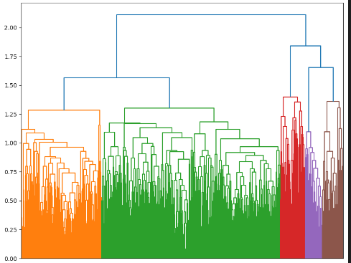
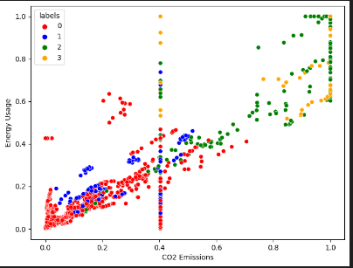
Model building :
Techniques used : kMeans, DBSCAN, Hierarchical.
Evaluation Metric: Silhouette Score.
Dimensionality Reduction: PCA for visualization.
Hierarchical Clustering with scaled data:
Visualized with Dendrogram and Scatter plot.
Scaled Data got a silhouette score - 0.4069002367119094

Slide 13
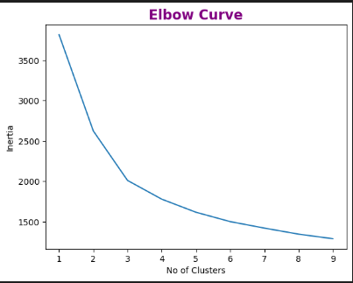
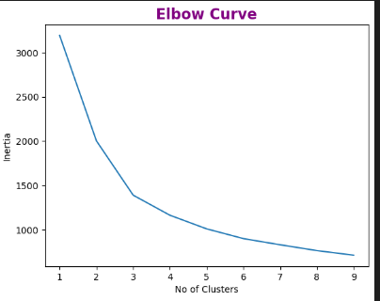
K-Means clustering on PCA Data:
By seeing the elbow curve considering 3 clusters.
K Means with 4 Clusters we got silhouette score - 0.38589504828738286
K Means with Clusters we got silhouette score -0.4592576382823015
K-Means with PCA Data – 3 clusters:
By seeing the above elbow curve considering 3 clusters.
K Means with PCA Data - 2 Clusters we got silhouette score -0.4349454775483713
K Means with PCA data - 4Clusters we got silhouette score -0.3016847742272087

Slide 14
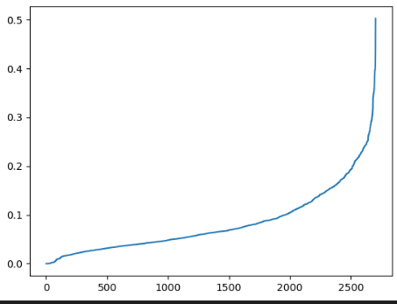
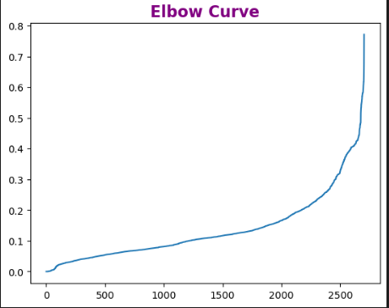
DBSCAN
Calculated distance by using the nearest neighbors method.
DBSCAN with Original Data - we got silhouette score -0.230808
DBSCAN with PCA Data - we got silhouette score -0.291135

Slide 15
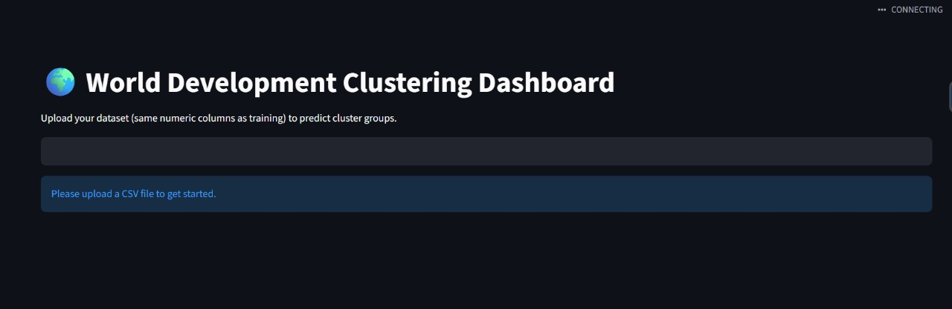
Deployment:
Platform: The final clustering application is deployed on a user-friendly platform , Streamlit.
Purpose: The deployed application will provide an interactive way for stakeholders to:
  Visualize the clusters and the countries within them.
  Explore the defining characteristics of each cluster.
  Gain actionable insights from the data in real-time.

Slide 16
Learnings: Future scope:
Gained insights into preprocessing socio-economic datasets
Observed strong correlations among key development indicators
Understood the application of clustering algorithms on real-world data
Learned to evaluate clustering performance using silhouette score and visualization
Extend analysis with time-series development data
Integrate environmental and governance indicators
Use advanced clustering (Gaussian Mixture Models, Spectral Clustering)
Apply supervised ML models for predictive analysis of country development

Slide 17
Thank You

